Slide 1
United Promotion Mfg Limited
Wood Pencils

Slide 2
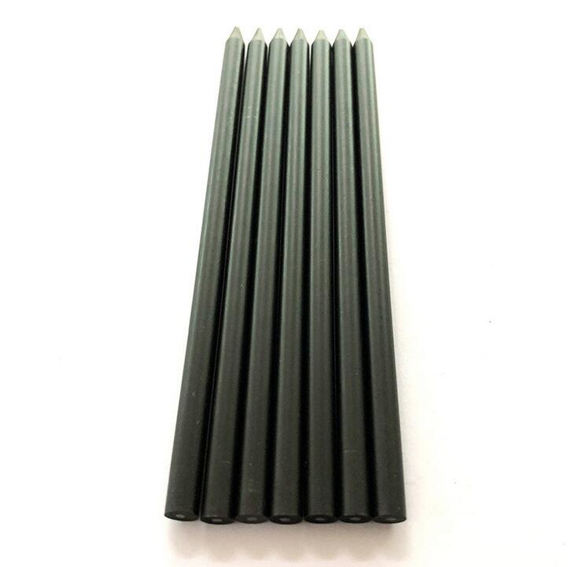
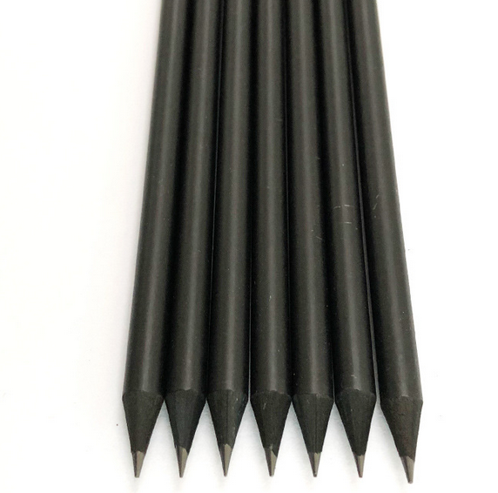
Black pencils
Black wood
HB lead
Standard size: 7’’
Custom logo is welcome
Imprint: Silk screen, hot stamping(Gold, silver)

Slide 3
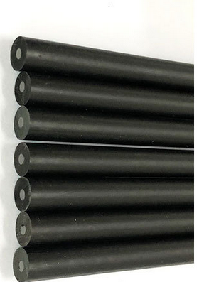
Without eraser
With eraser

Slide 4
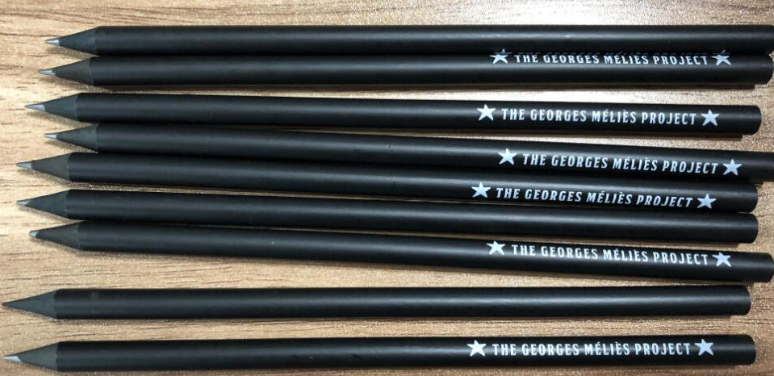
Silk screen printing
Gold stamping

Slide 5
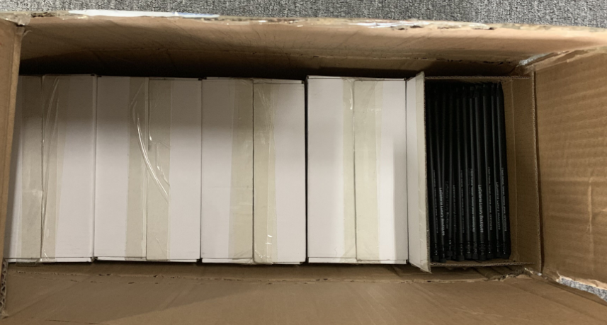
Packing
250 pcs/inner box, 3000 pcs per carton

Slide 6
Low quantity with your logo
Qty (Pcs) | EXW price (USD/PC) | Production time | Logo set up fee
500 –1000 pcs | $0.40 | 15 days | $35/color
2000-5000 pcs | $0.36 | 18 days | $35/color
5000-10000 pcs | $0.32 | 20 days | $35/color
MOQ 500 pcs for 1 color logo with silk screen 2 colors logo, MOQ 1000 pcs with silk screen

Slide 7
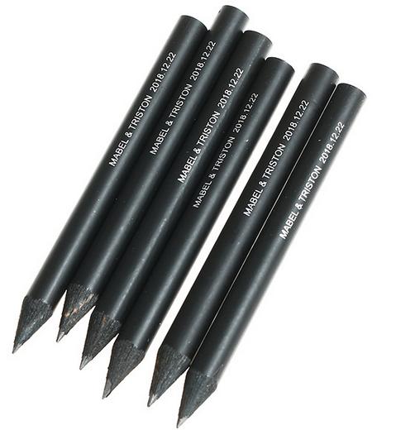
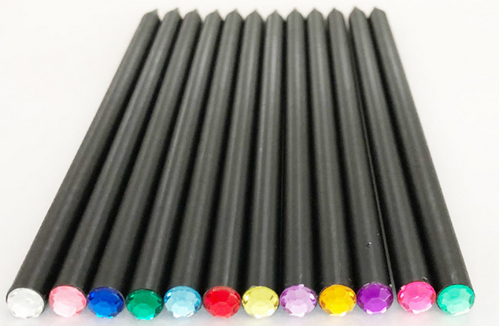
Other pencils
Natural wood pencil
Golf pencil
Black pencil with diamond top

